Slide 1
PRESENTED BY:
[INSERT NAME; HOSPITAL]

Slide 3
gggggggggggggggggggggA AUSTRALIAg
Total number of hip fractures : 11,482
Age at admission
The average age of hip fracture patients was 81 years
People aged 90 years and older made up 25% of hip fracture patients
Sex
Females comprised 66% of hip fracture patients
Usual place of residence
72% of people admitted with a hip fracture lived at home prior to their injury.
28% of people were admitted from residential care
Preadmission cognitive status
37% of patients had pre-existing impaired cognition or known dementia
Preadmission walking ability
44% of hip fracture walked without a walking aid

Slide 4
NEW ZEALAND
Total number of hip fractures: 3,334
Age at admission
The average age of hip fracture patients was 82 years
People aged 90 years and older made up 27% of hip fracture patients
Sex
Females comprised 69% of hip fracture patients
Usual place of residence
71% of people admitted with a hip fracture lived at home prior to their injury
28% of people were admitted from residential care
Preadmission cognitive status
36% of patients had pre-existing impaired cognition or known dementia
Preadmission walking ability
41% of hip fracture walked without a walking aid

Slide 9
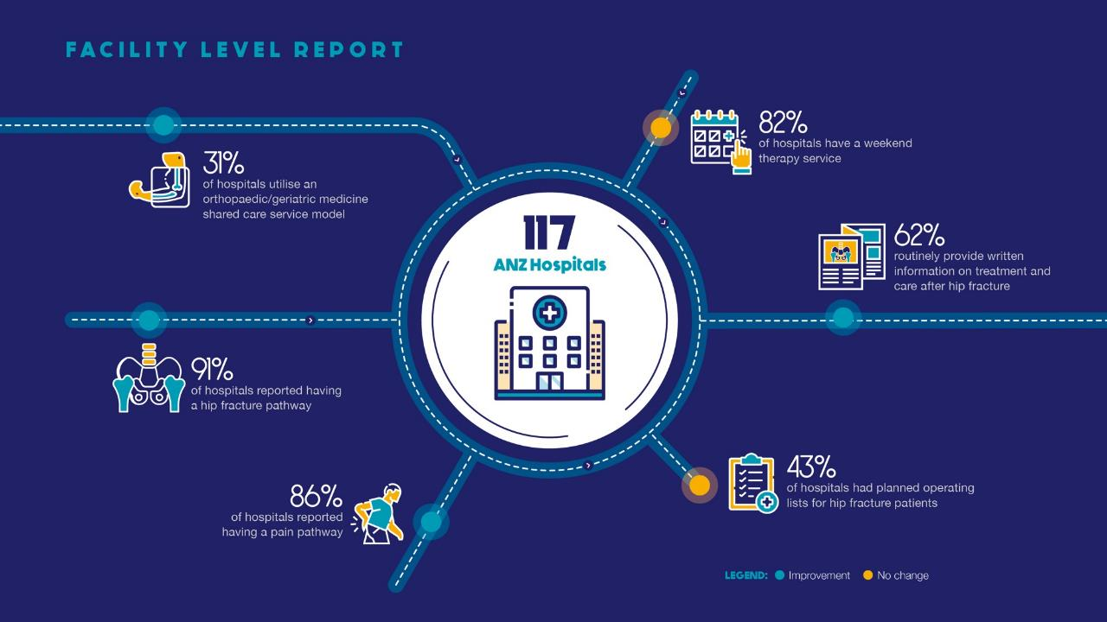

Slide 13
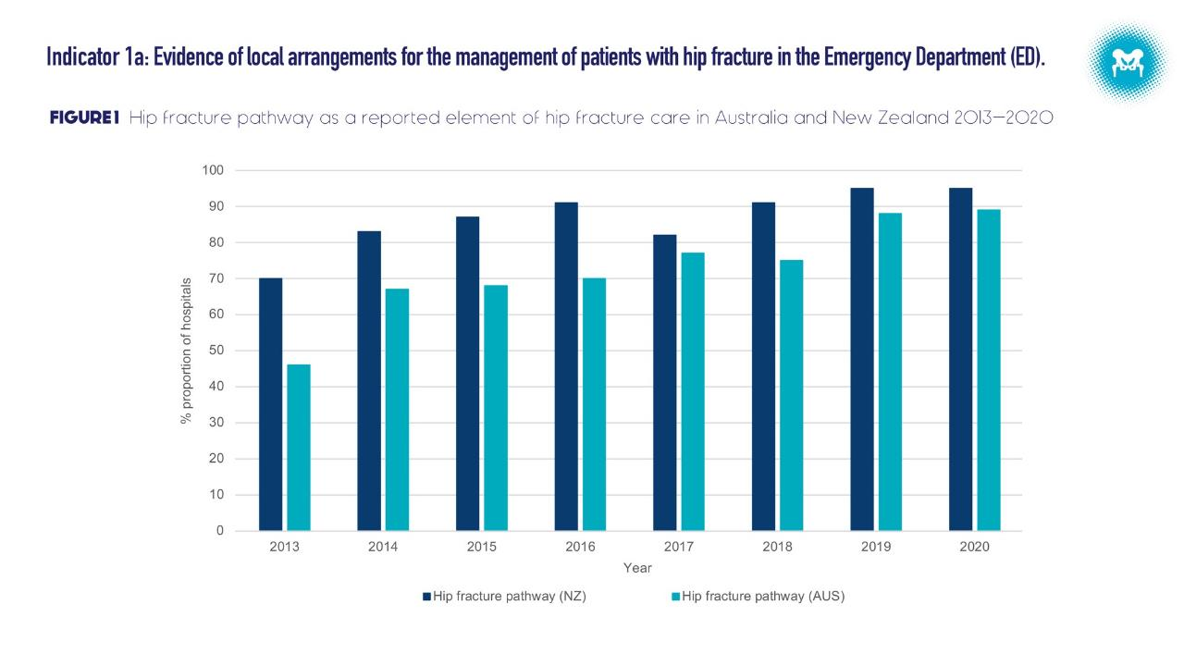

Slide 14
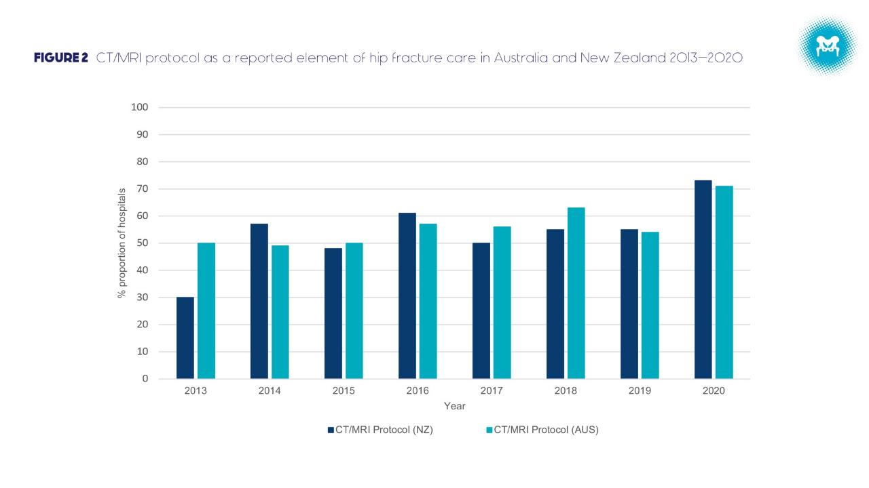

Slide 15
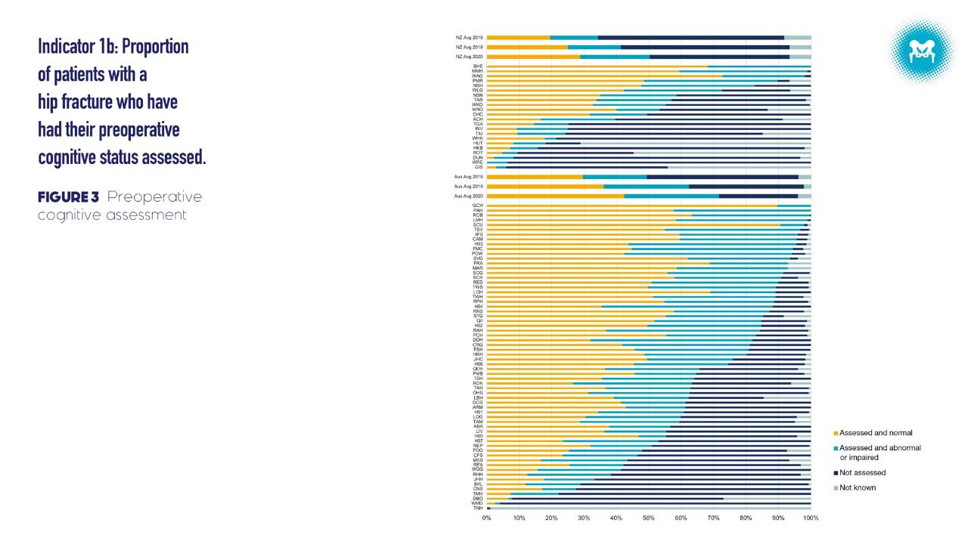
USE THIS AREA TO HIGHLIGHT HOSPITAL RESULTS

Slide 17
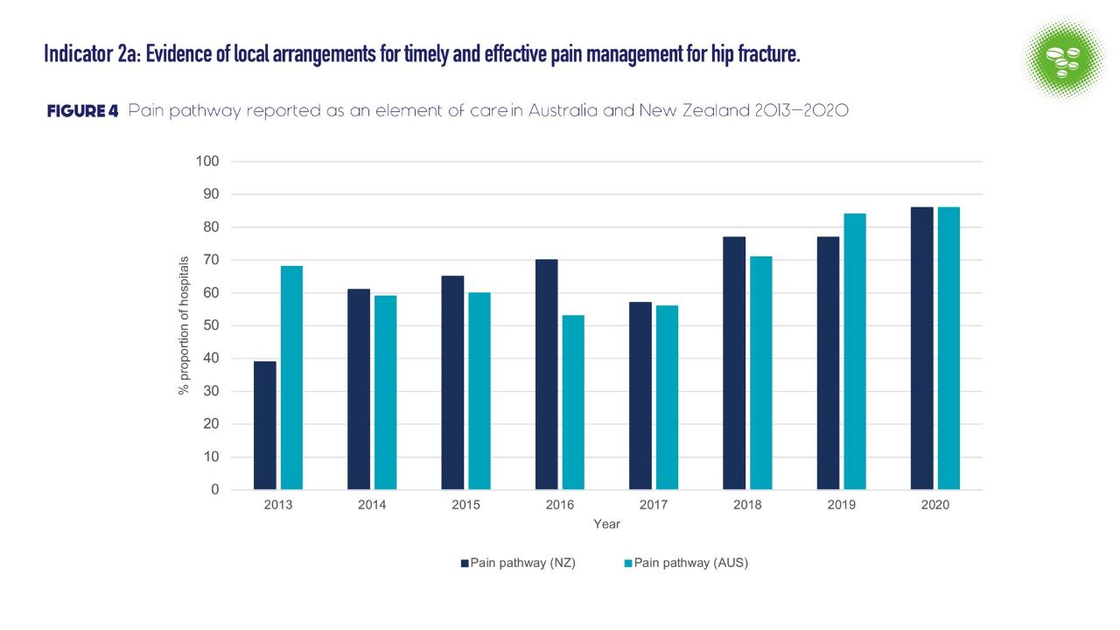

Slide 18
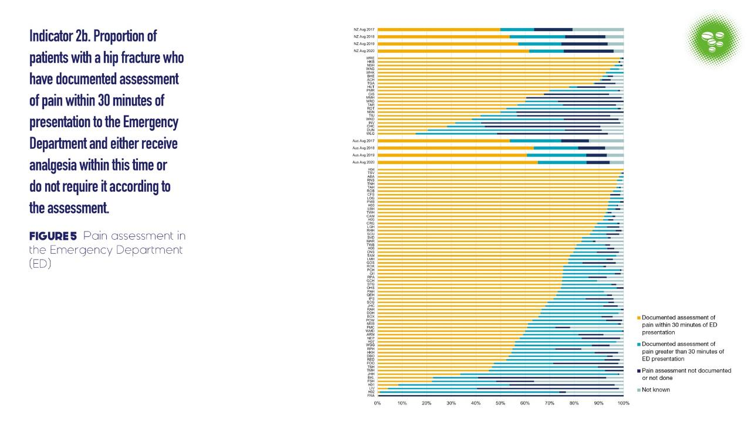
USE THIS AREA TO HIGHLIGHT HOSPITAL RESULTS

Slide 19
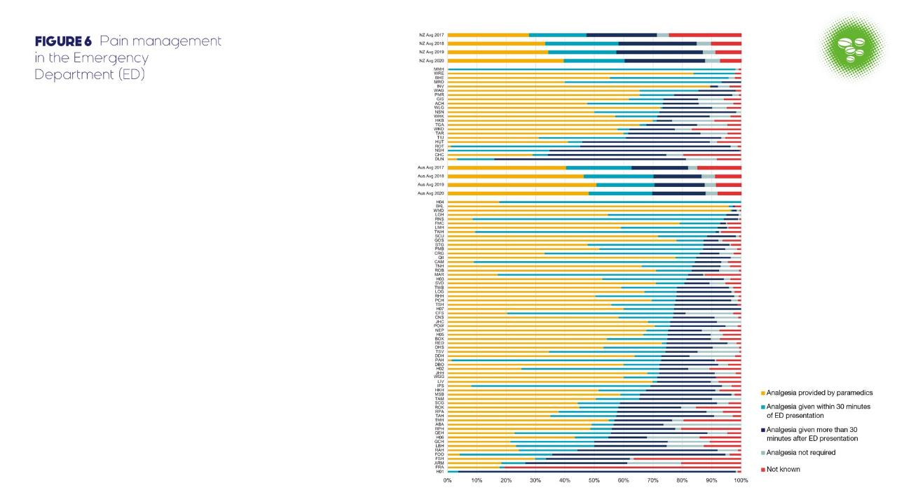
USE THIS AREA TO HIGHLIGHT HOSPITAL RESULTS

Slide 21
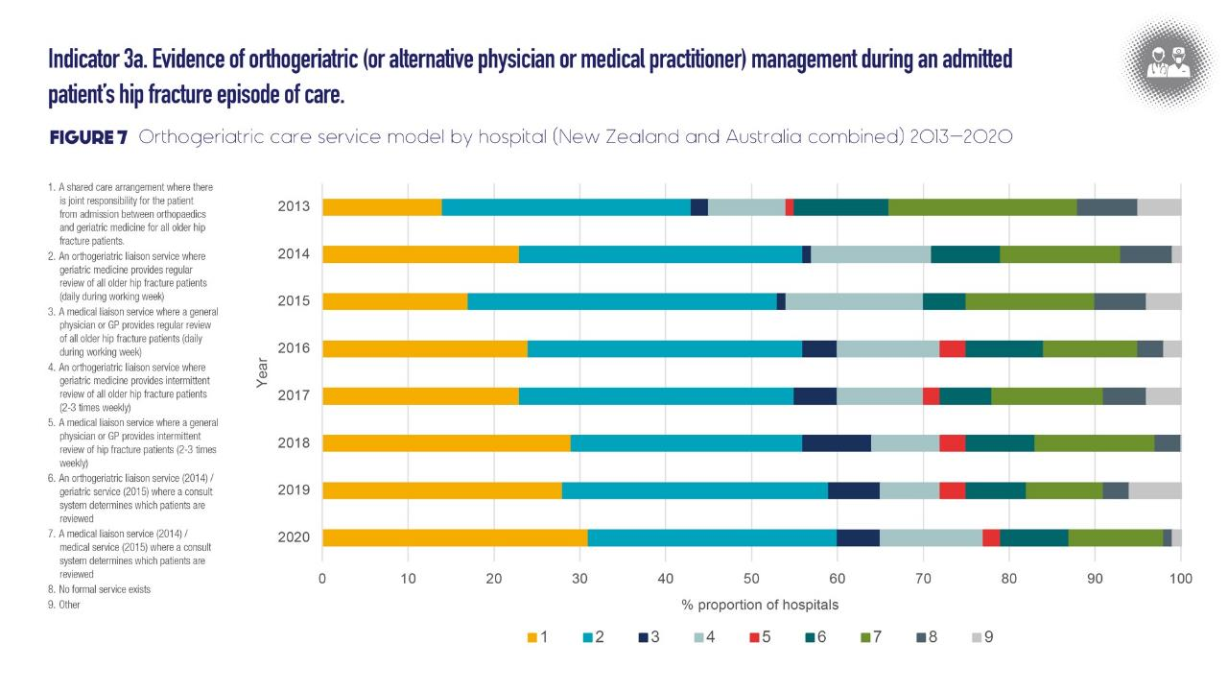

Slide 22
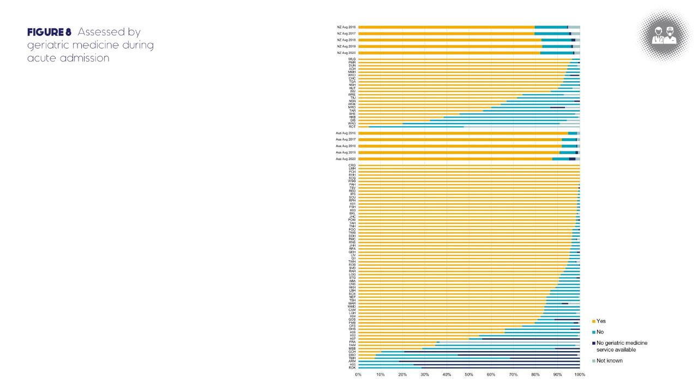
USE THIS AREA TO HIGHLIGHT HOSPITAL RESULTS

Slide 24
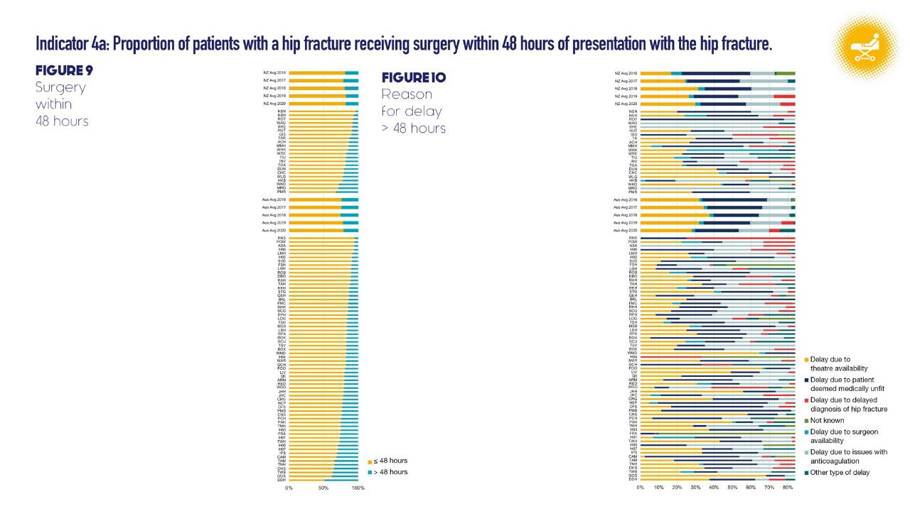
USE THIS AREA TO HIGHLIGHT HOSPITAL RESULTS
USE THIS AREA TO HIGHLIGHT HOSPITAL RESULTS

Slide 26
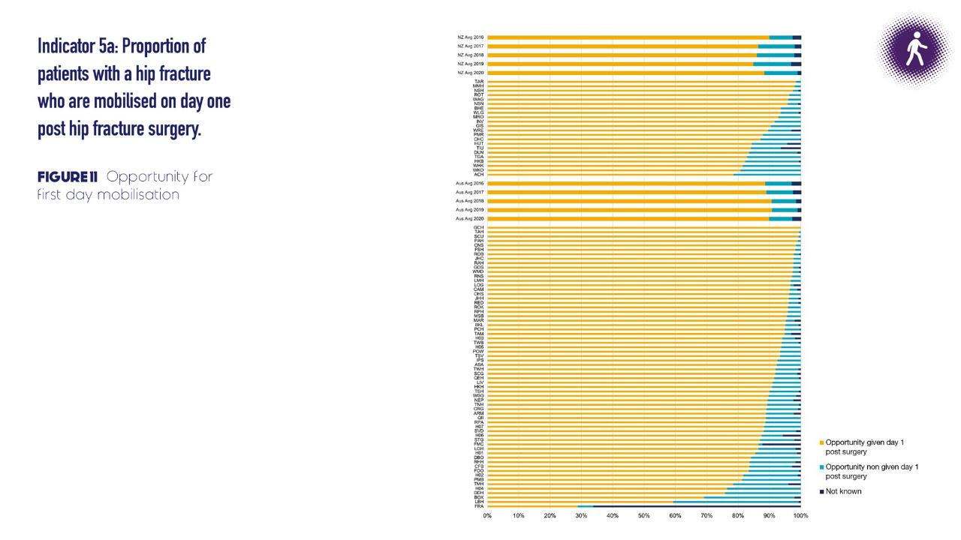
USE THIS AREA TO HIGHLIGHT HOSPITAL RESULTS

Slide 27
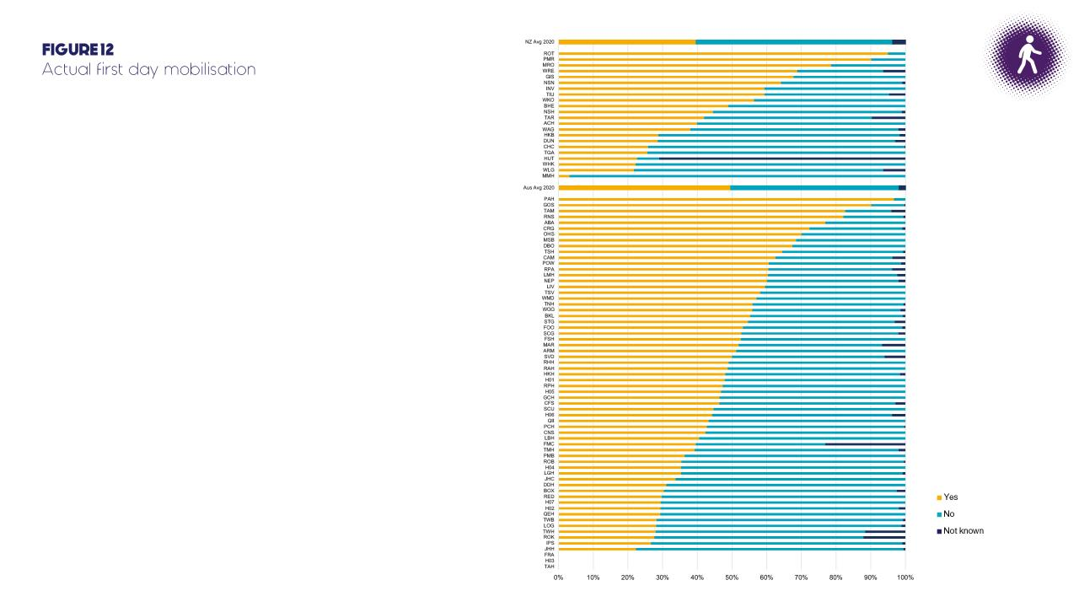
USE THIS AREA TO HIGHLIGHT HOSPITAL RESULTS

Slide 28
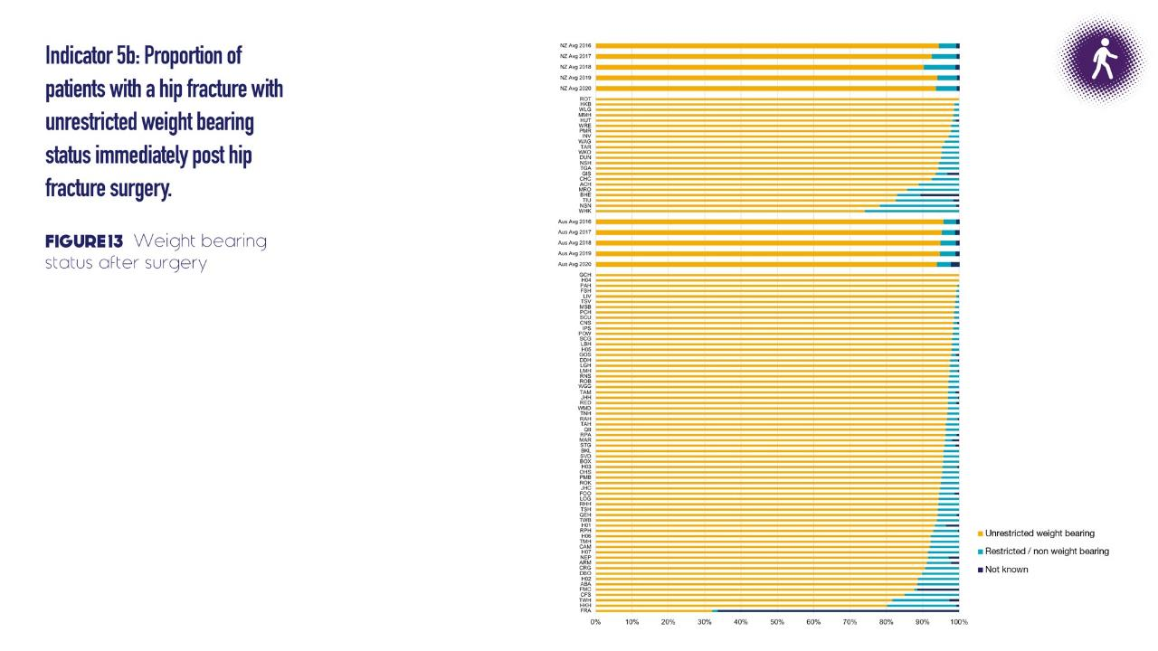
USE THIS AREA TO HIGHLIGHT HOSPITAL RESULTS

Slide 29
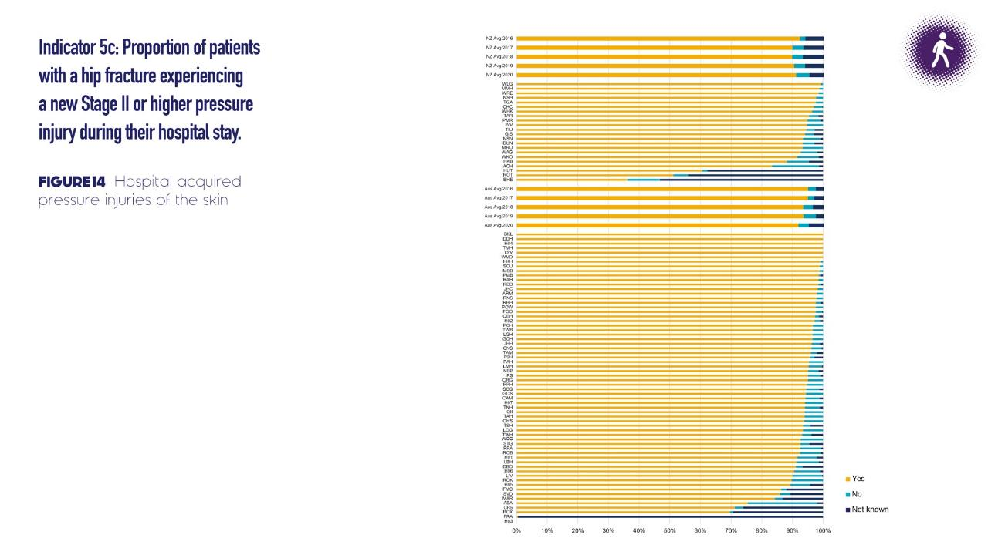
USE THIS AREA TO HIGHLIGHT HOSPITAL RESULTS

Slide 30
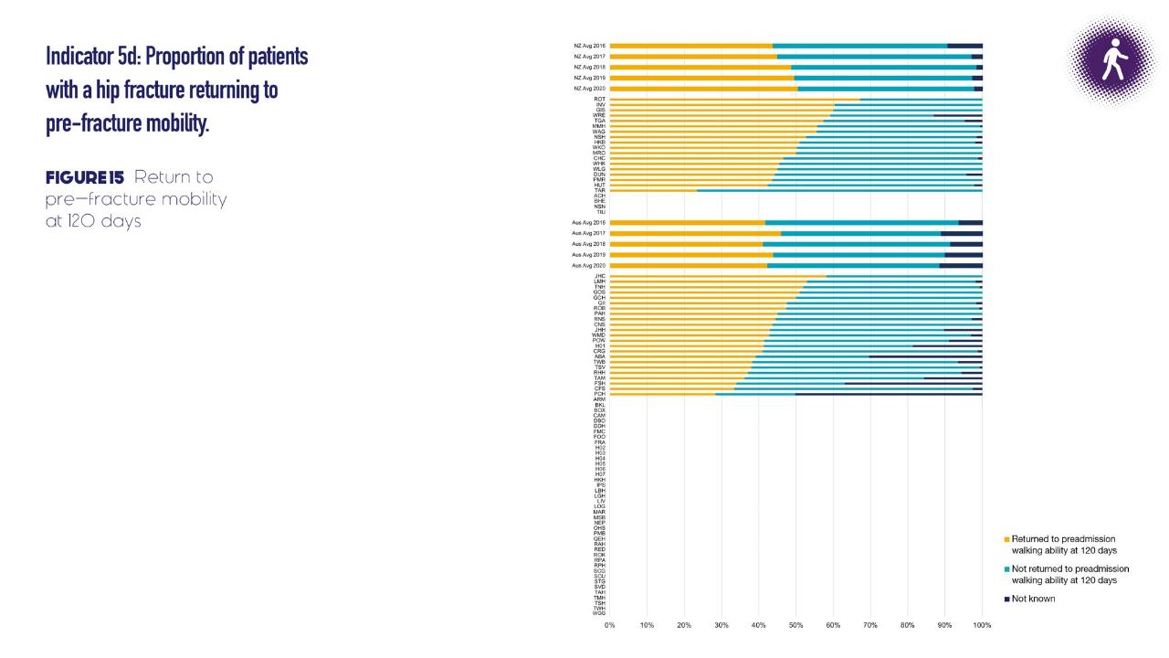
USE THIS AREA TO HIGHLIGHT HOSPITAL RESULTS

Slide 32
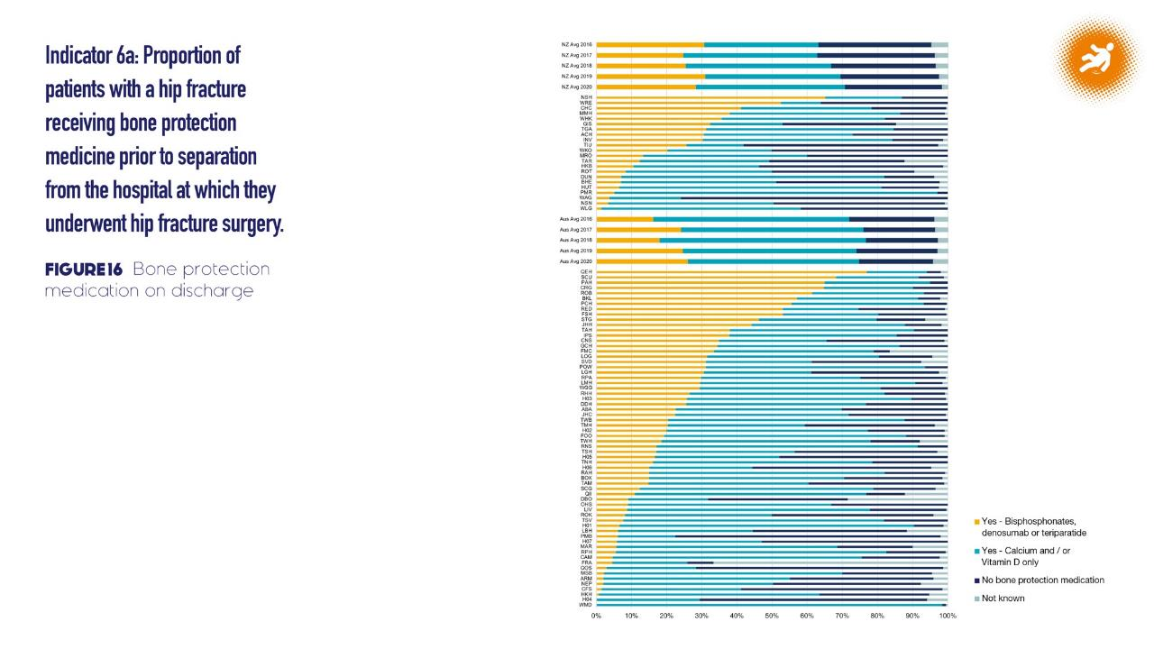
USE THIS AREA TO HIGHLIGHT HOSPITAL RESULTS

Slide 34
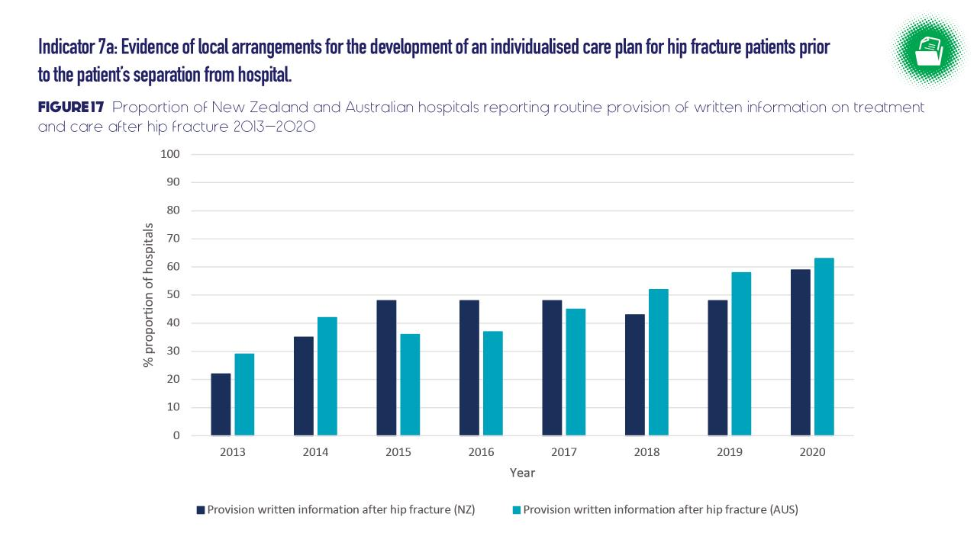

Slide 35
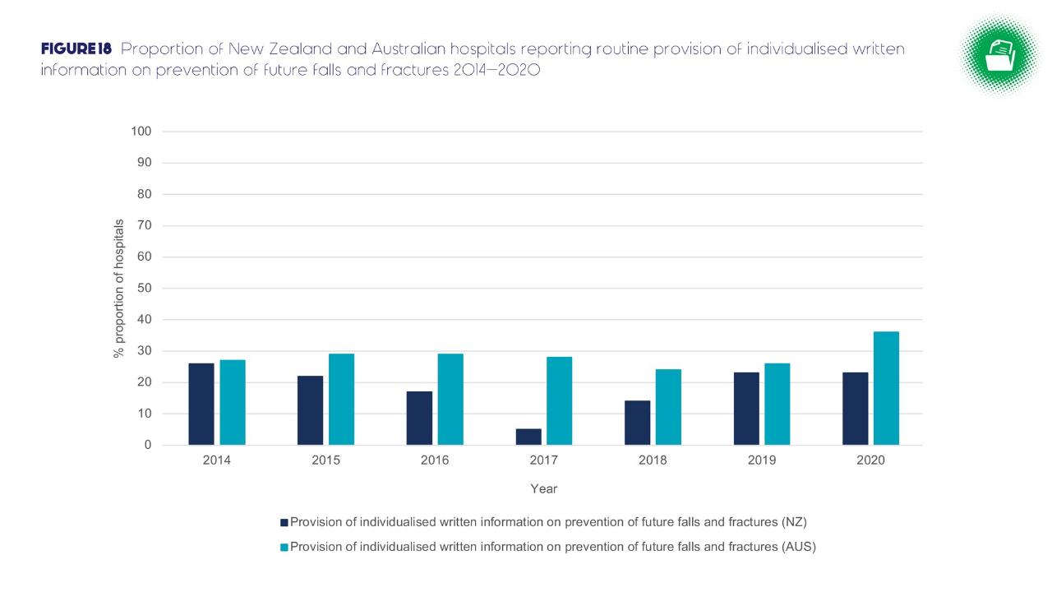

Slide 36
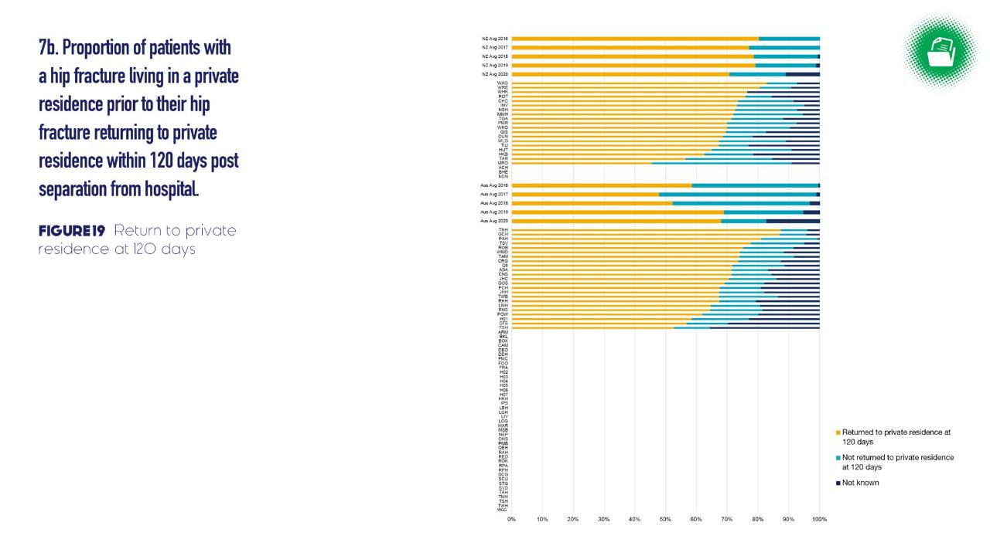
USE THIS AREA TO HIGHLIGHT HOSPITAL RESULTS

Slide 38
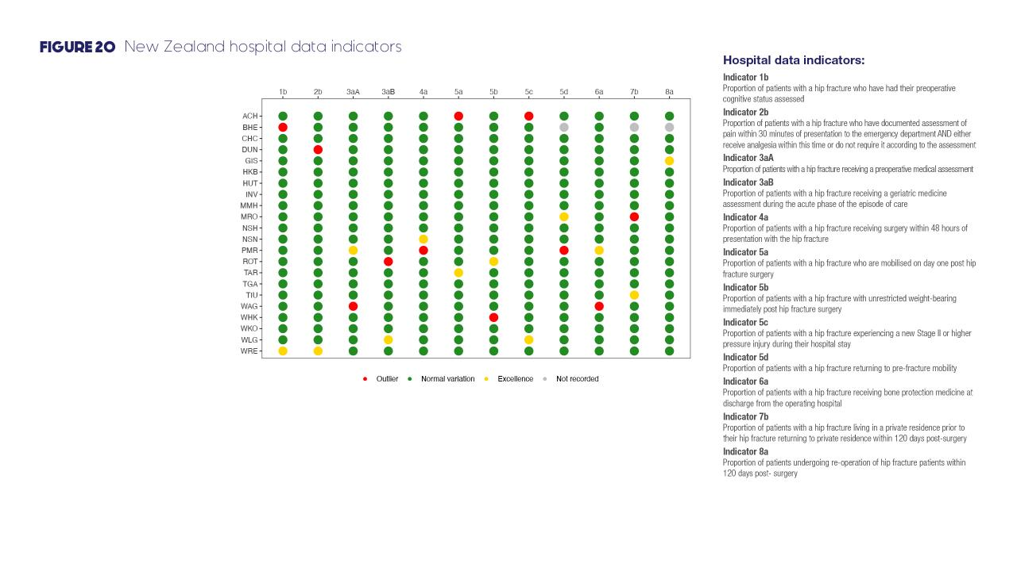
USE THIS AREA TO HIGHLIGHT HOSPITAL RESULTS

Slide 39
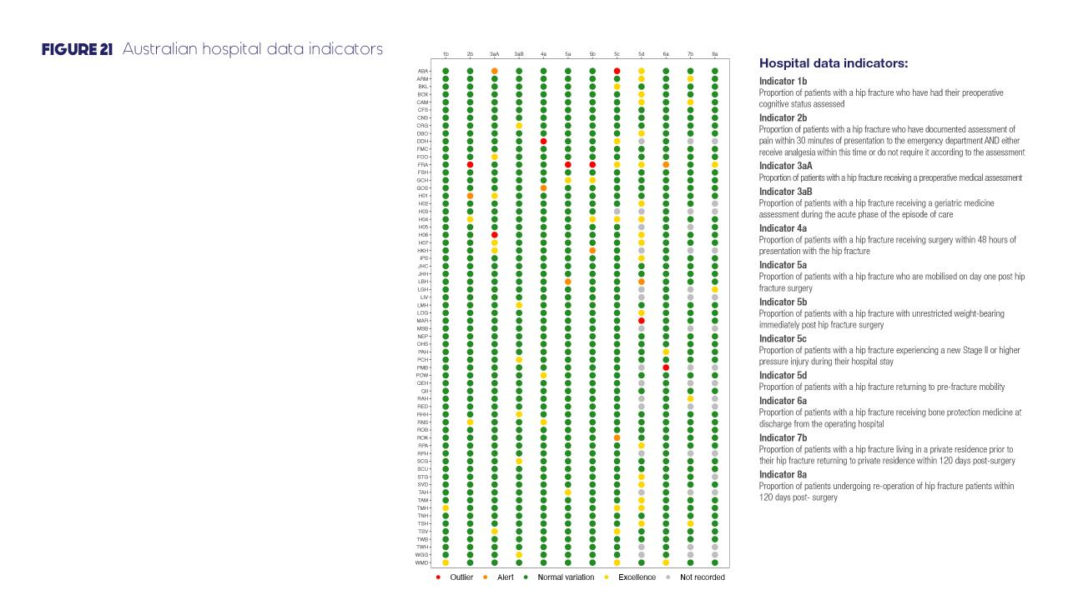
USE THIS AREA TO HIGHLIGHT HOSPITAL RESULTS

Slide 40
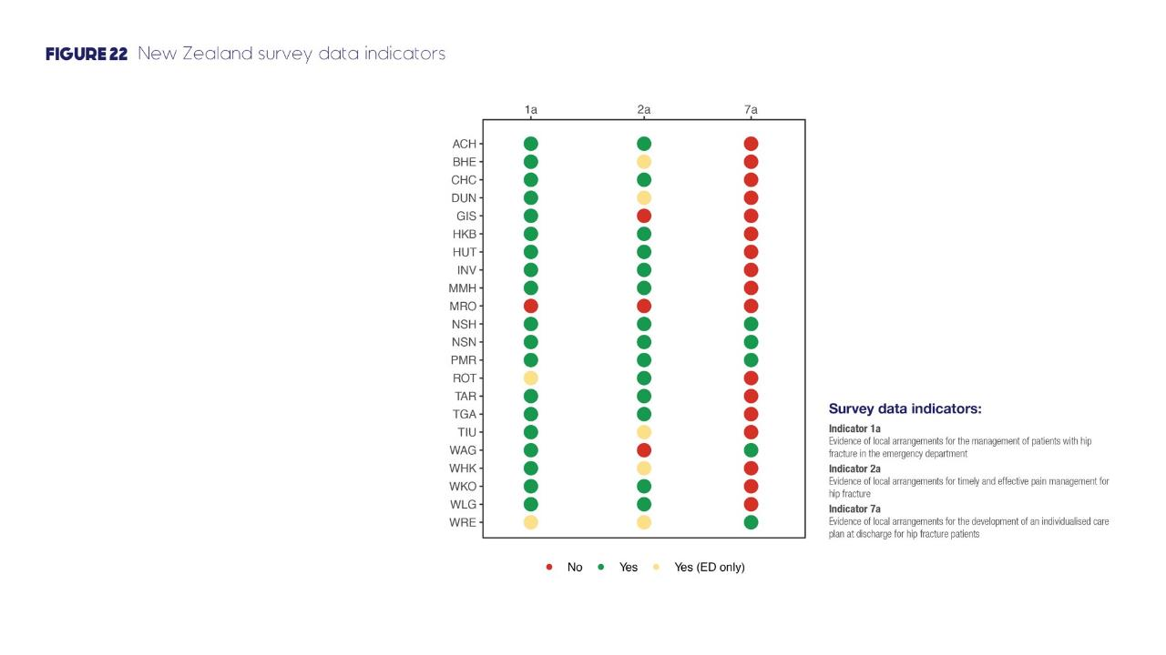
USE THIS AREA TO HIGHLIGHT HOSPITAL RESULTS

Slide 41
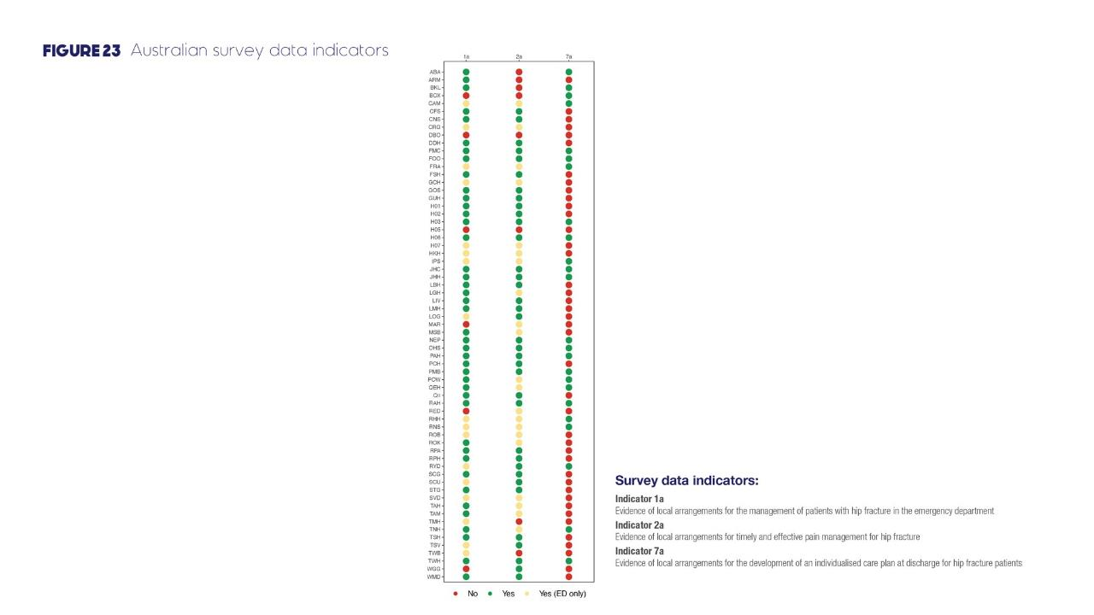
USE THIS AREA TO HIGHLIGHT HOSPITAL RESULTS

Slide 43
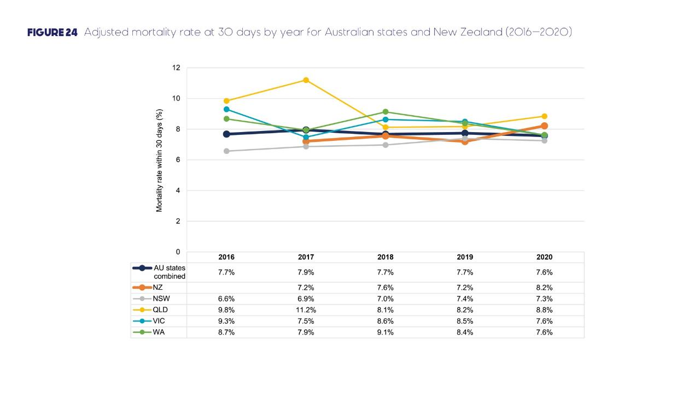

Slide 44
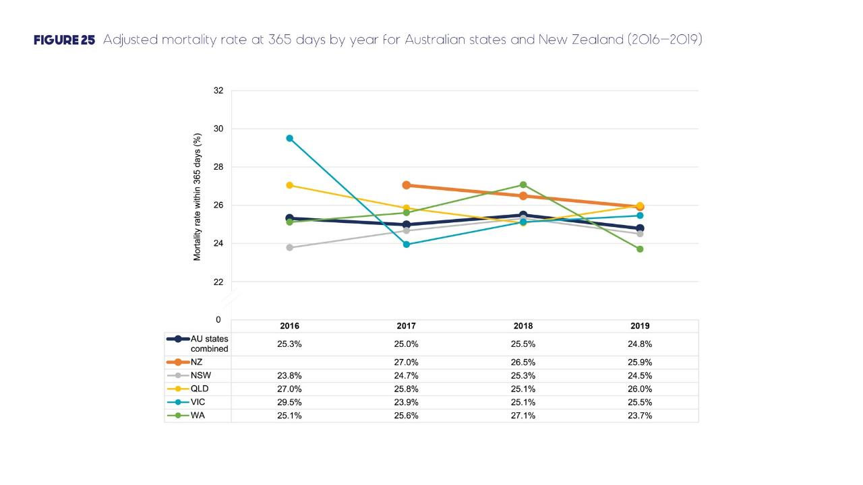

Slide 45
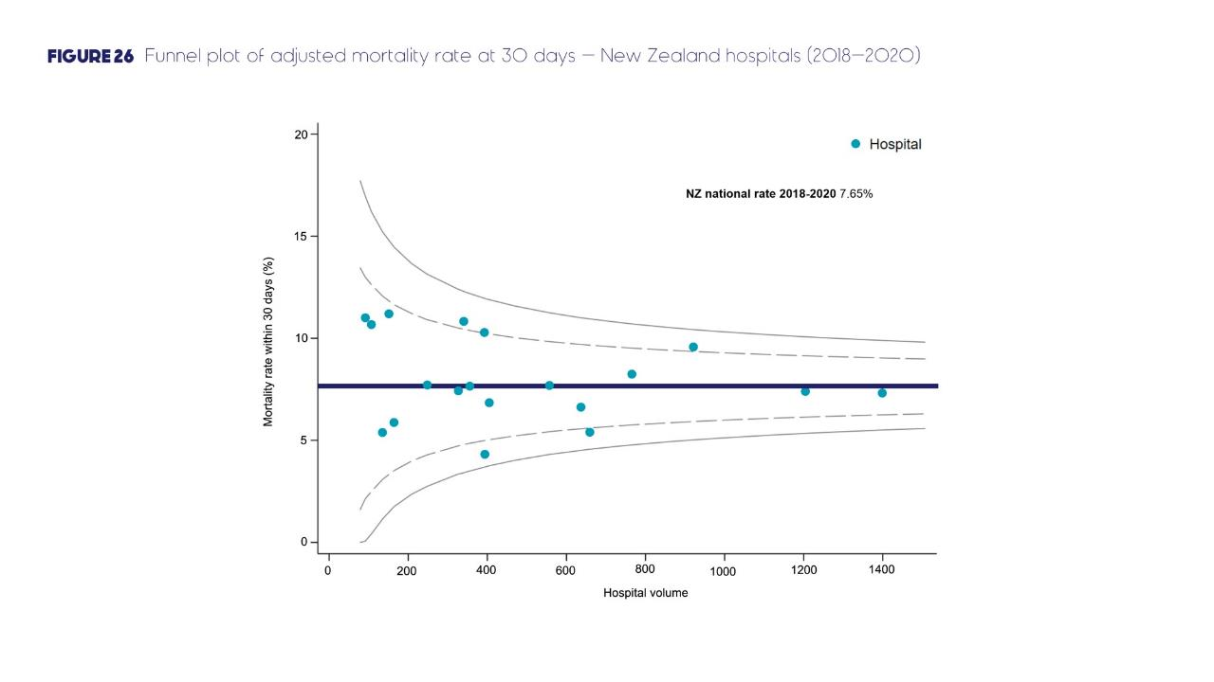

Slide 46
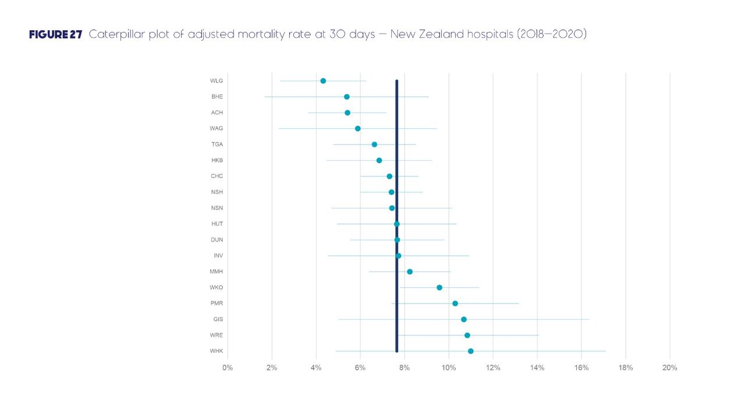
USE THIS AREA TO HIGHLIGHT HOSPITAL RESULTS

Slide 47
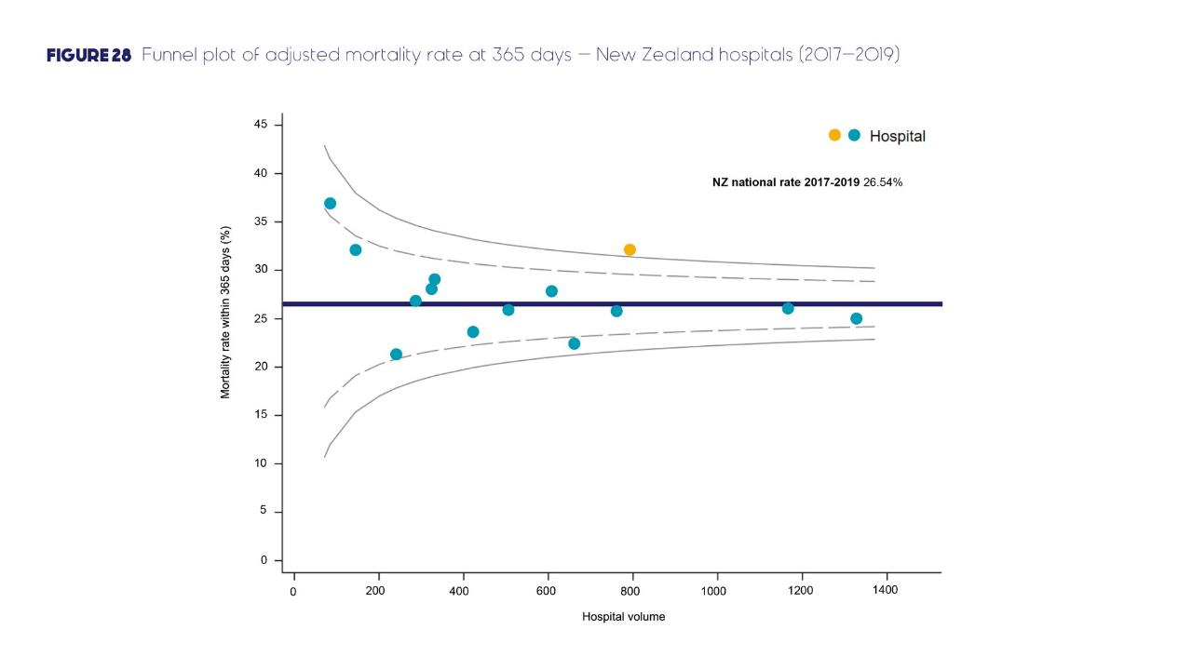

Slide 48
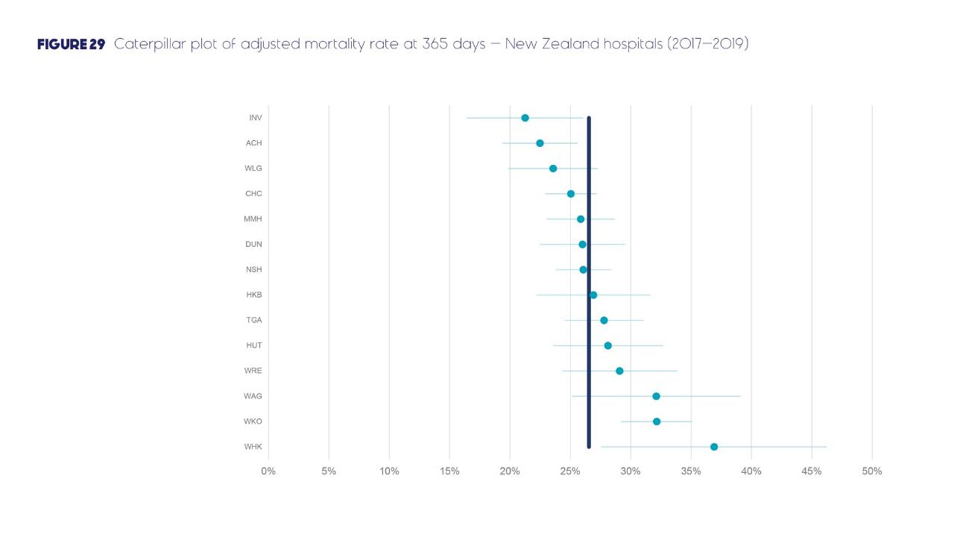
USE THIS AREA TO HIGHLIGHT HOSPITAL RESULTS

Slide 49
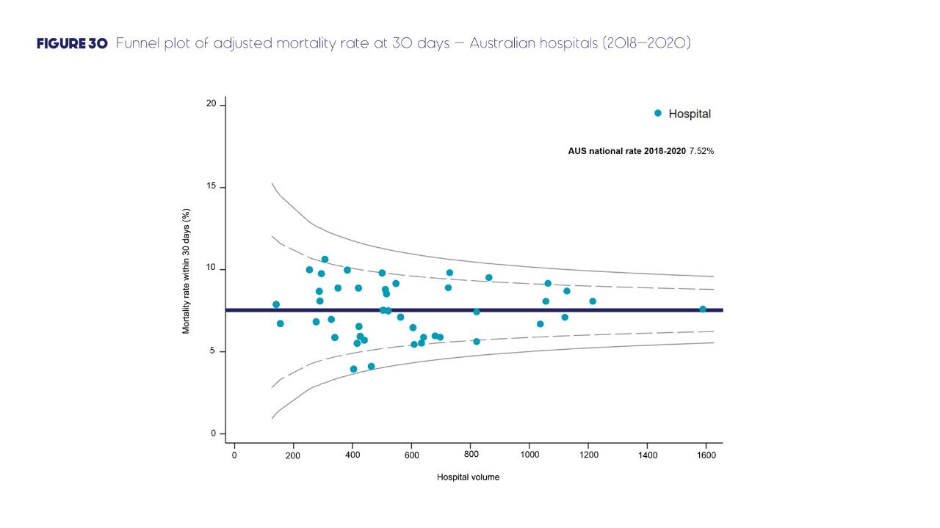

Slide 50
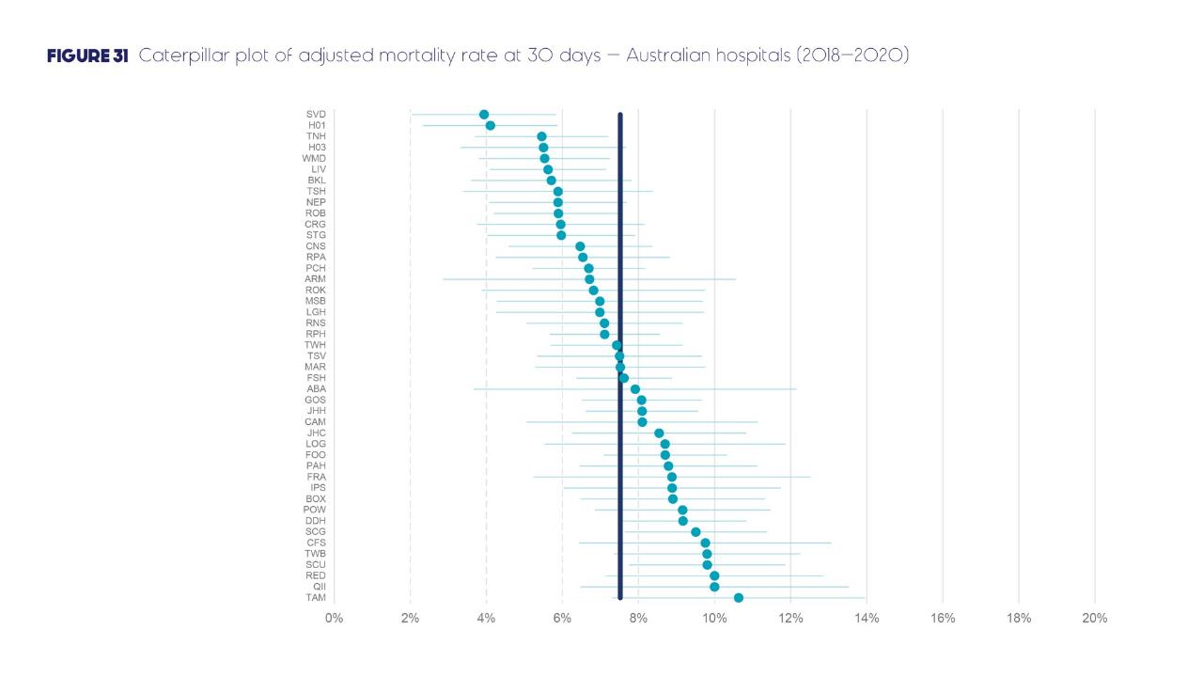
USE THIS AREA TO HIGHLIGHT HOSPITAL RESULTS

Slide 51
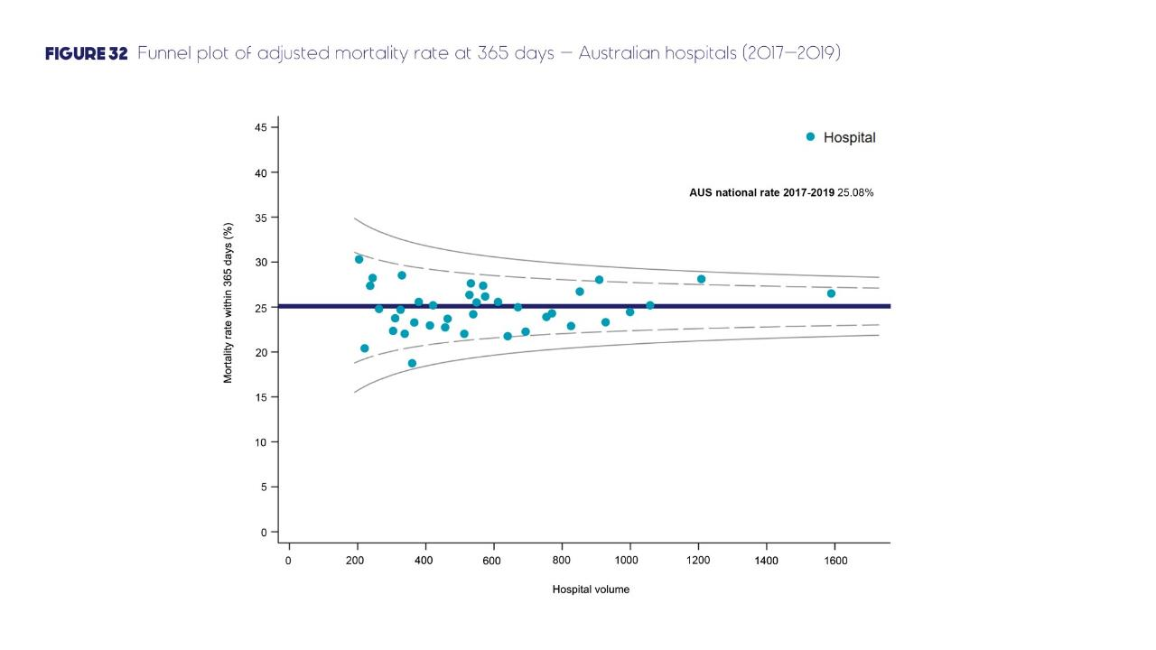

Slide 52
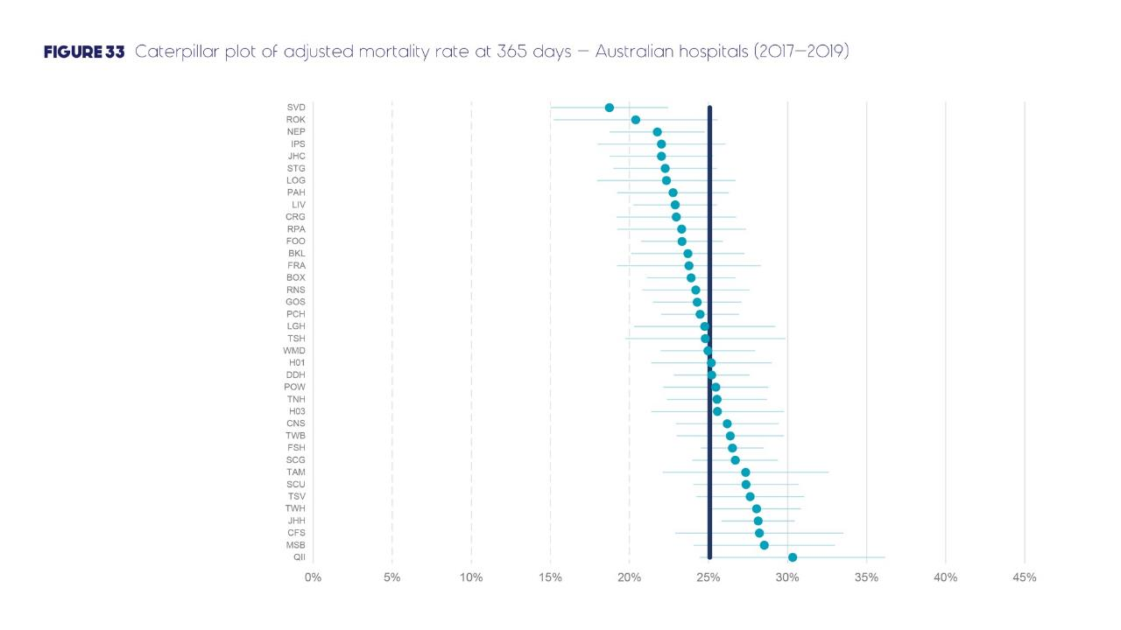
USE THIS AREA TO HIGHLIGHT HOSPITAL RESULTS

Slide 53
Text here

